Slide 1
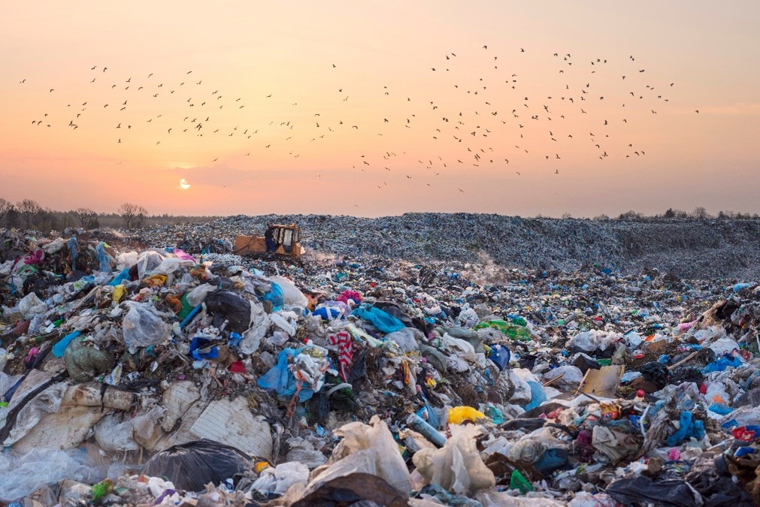
EcoSort
Rohan Kumar
Shark Tank Presidium
2024

Slide 2

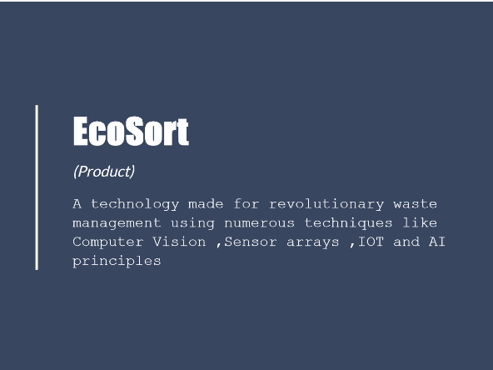
What is EcoSort?

Slide 3
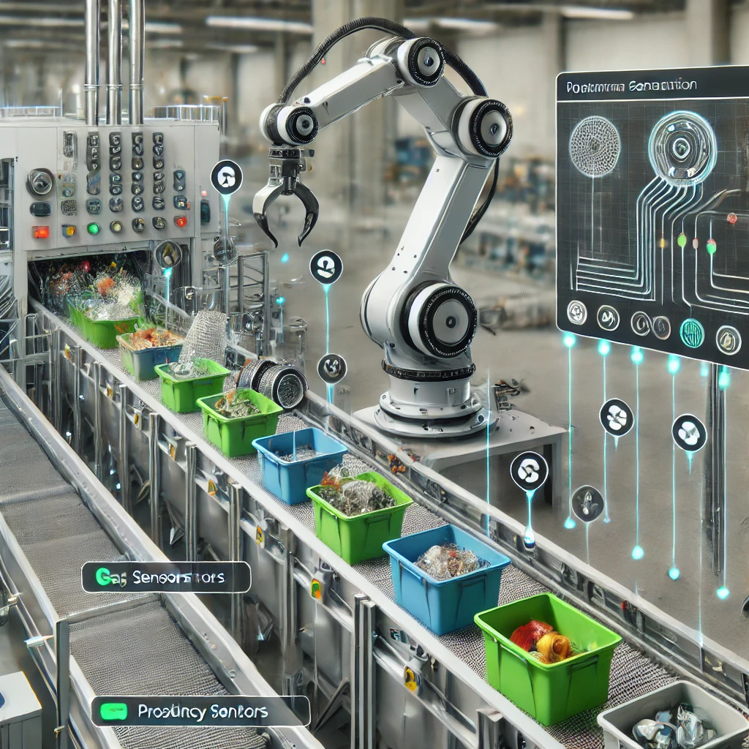
The EcoSort Vision
Waste as resource
Smart, AI-driven solutions
Accessible, sustainable practices
Efficient recycling systems

Slide 4
Sustainability
11-Sustainable Cities and Communities
12: Responsible Consumption and Production
6- Clean water and sanitation
3-Good health and well being
13 – climate action

Slide 5
How To Solve Waste?
Improve Waste Collection and Segregation
Expand Recycling and Reuse Programs
Waste-to-Energy Conversion

Slide 6
Step 1 – Segregation
Segregation
Why?
Prevents Contamination
Landfills eradicated
Facilitates recycle and reuse
Supports waste to energy

Slide 7
The Modular Method
Capture Waste Image
AI Analysis
Coordinate Mapping
Automated Sorting
Data Collection
Final Disposal
This is The EcoSort Methodology.
The innovative way to segregate waste

Slide 8
A Method, Not Just a Product
Factories
Stationery robots
Build kits
Mobile robots
They can all be EcoSort
EcoSort is a scalable methodology for waste segregation. Its modular approach allows integration across various platforms:
Adaptable and versatile

Slide 9
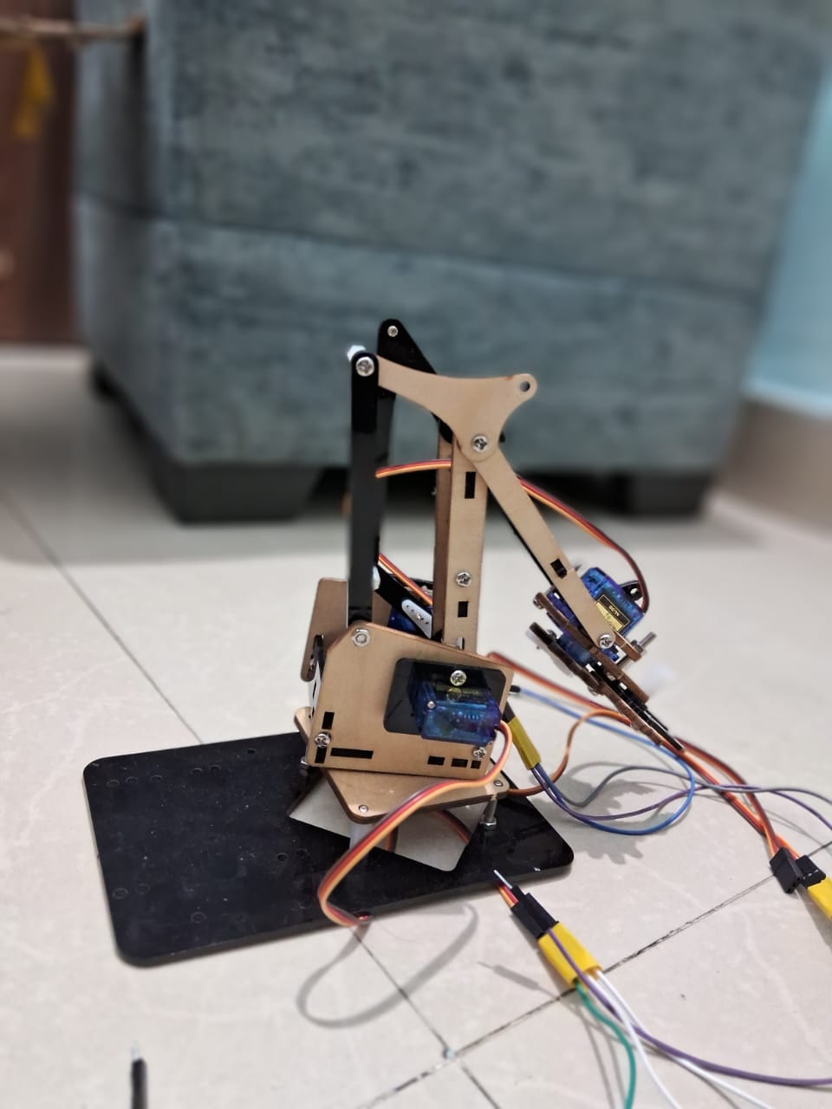
Testing – Prototype
EcoSort
Grassroots V1

Slide 10
Uno
1
One
Une
This is step
Ein
Odin

Slide 11

Investment Request
14 lakh INR for
5% equity

Slide 12

THANK
YOU!
Rohan Kumar

